Slide 1
Non-linear Data Structures-
Trees

Slide 2
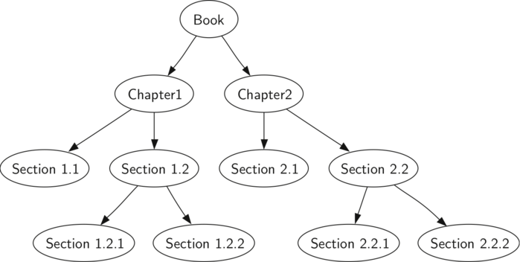
Trees
Root
leaf

Slide 3
Trees
Tree is an abstract model of a hierarchical structure.
A tree consists of nodes with a parent- child relation.
Applications:
Organization charts
File systems
Programming environments.

Slide 4
Definition of Tree
A tree is a finite set of one or more nodes
such that:
There is a specially designated node called
the root.
The remaining nodes are partitioned into n>=0 disjoint sets T1, ..., Tn, where each of these sets is a tree.
We call T1, ..., Tn the subtrees of the root.

Slide 5
Binary Trees
A binary tree is a finite set of nodes that is
either empty or consists of a root and two
disjoint binary trees called the left subtree
and the right subtree.
The left subtree and the right subtree are distinguished.

Slide 6
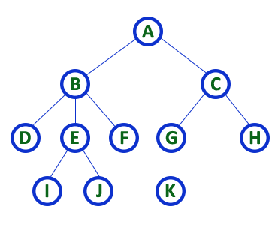
General Trees

Slide 7
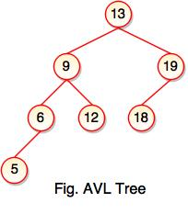
Binary Tree

Slide 8
Tree Terminology
Root: node without parent
Internal Node: node with at least one child
External Node (or Leaf node): Node without children
Ancestors of a node: parent, grandparent etc.
Sub tree: tree consisting of a node and its descendants.
Siblings: Children of the same parent.
In degree: number of nodes arriving at that node
Out degree: number of nodes leaving that node
Degree of node: number of subtrees of the node
Level of a node: Depth of a node w.r.t root
Height of a tree: maximum level in a tree

Slide 9
Types of Binary Tree
Skewed Binary Tree
A
A
B
B
C
D
E

Slide 10
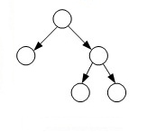
Types of Binary Tree
Full Binary Tree/Strictly Binary Tree
A Binary Tree is full if every node has 0 or 2 children.

Slide 11
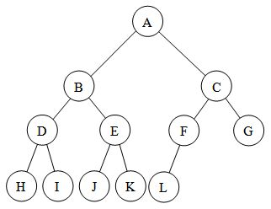
Types of Binary Tree
Complete Binary Tree
A Binary Tree is complete Binary Tree if all levels are completely filled except possibly the last level and the last level has all keys as left as possible

Slide 12
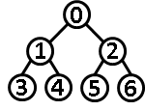
Types of Binary Tree
Perfect Binary Tree
A Binary tree is Perfect Binary Tree in which all internal nodes have two children and all leaves are at same level.

Slide 13
Types of Binary Tree
Balanced Binary Tree
A binary tree is balanced if height of the tree is O(Log n) where n is number of nodes.

Slide 14
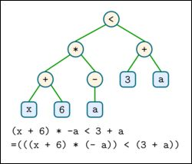
Expression Tree
Types of Binary Tree

Slide 15
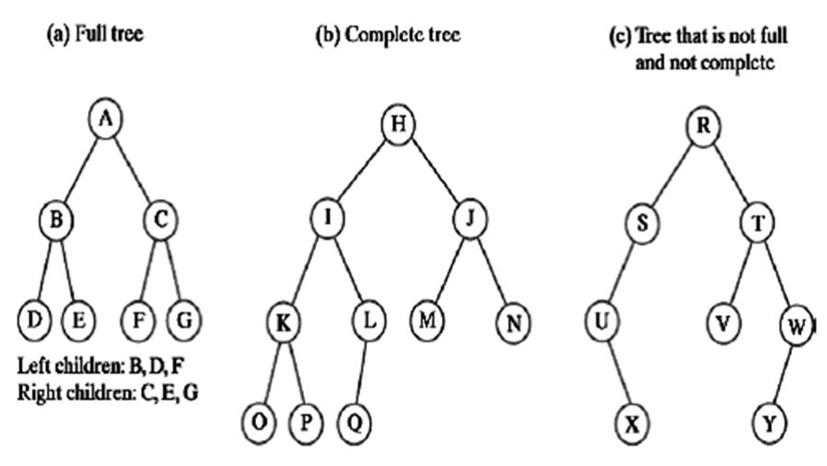
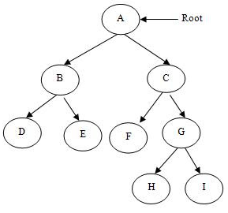
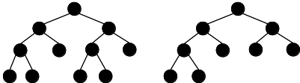
Identify the type of binary tree
(a)
(b)
(c)
(d)
(e)
(f)

Slide 16
Identify the type of binary tree
(a) Perfect
(b) Complete
(c) Simple binary tree
(d) Full
(e) Full and complete
(f) full

Slide 17





Sequential Representation
[1]
[2]
[3]
[4]
[5]
[6]
[7]
[8]
[9]
A
B
C
D
E
F
G
H
I
A
B
C
D
E
F
G
H
I

Slide 18











CHAPTER 5

Slide 19
Sequential Representation
A
[1]
[2]
[3]
[4]
[5]
[6]
[7]
[8]
[9]
.
[16]
A
B
--
C
--
--
--
D
--
.
E
B
C
D
E

Slide 20
Binary Tree Representations
If a complete binary tree with n nodes is represented sequentially, then for any node with index i, 1<=i<=n, we have:
- left_child(i) is at 2i if 2i<=n. If 2i>n, then i has no
left child.
  right_child(i) is at 2i+1 if 2i +1 <=n. If 2i +1 >n,
  then i has no right child.
  parent(i) is at i/2 if i!=1. If i=1, i is at the root and
  has no parent.

Slide 21
Binary Tree Representation
data
left child
right sibling
# A Python class that represents an individual node # in a Binary Tree class Node: def __init__(self,key): self.left = None self.right = None self.val = key

Slide 22
Binary Tree Traversal Methods
Preorder
Inorder
Postorder
Level order

Slide 23
Preorder Traversal NLR
def preOrder(ptr):
if (ptr != NULL):
print (ptr.data)
preOrder(ptr.leftChild)
preOrder(ptr.rightChild)
Notes:
Ptr points to the root of the subtree being traversed.

Slide 24
Preorder Example (NLR)
NLR
A
a
B
NLR
b
c
NLR
C
A
B
C

Slide 25
Preorder Example (NLR)
NLR
a
A
NLR
B
c
b
C
NLR
NLR
D
E
NLR
A, B, D, E, C

Slide 26
Preorder Example (NLR)
a
N
A
b
c
B
C
D
E
d
F
G
H
I
J
Notes:
During the traversal, t starts at the root, moves to the left child b of the root, then to the left child d of b. When the traversal of the left subtree of b is complete, t, once again, points to the node b. The t moves into the right subtree of b. When the traversal of this right subtree is complete, t again points to b. Following this, t points to a. We see that t points to every node in the binary tree three times – once when you get to the node from its parent (or in the case of the root, t is initially at the root), once when you return from the left subtree of the node, and once when you return from the node’s right subtree. Of these three times that t points to a node, the node is visited the first time.

Slide 27
Preorder Example (NLR)
a
A
b
c
B
C
D
E
d
F
G
H
I
J
A
B
D
G
H
E
I
C
F
J
Notes:
During the traversal, t starts at the root, moves to the left child b of the root, then to the left child d of b. When the traversal of the left subtree of b is complete, t, once again, points to the node b. The t moves into the right subtree of b. When the traversal of this right subtree is complete, t again points to b. Following this, t points to a. We see that t points to every node in the binary tree three times – once when you get to the node from its parent (or in the case of the root, t is initially at the root), once when you return from the left subtree of the node, and once when you return from the node’s right subtree. Of these three times that t points to a node, the node is visited the first time.

Slide 28
Inorder Traversal LNR
def inOrder(ptr):
if (ptr != NULL):
inOrder(ptr.leftChild)
print(ptr.data)
inOrder(ptr.rightChild)

Slide 29
Inorder Example (LNR)
LNR
A
a
LNR
B
LNR
b
c
C
B
A
C

Slide 30
Inorder Example (LNR)
a
A
B
c
b
C
D
E
D B E A C

Slide 31
Inorder Example (LNR)
a
A
b
c
B
C
D
E
d
F
G
H
I
J

Slide 32
Inorder Example (LNR)
a
A
b
c
B
C
D
E
d
F
G
H
I
J
G
D
H
B
E
I
A
F
J
C

Slide 33





Postorder Traversal
def postOrder(ptr):
if (ptr != NULL):
postOrder(ptr.leftChild)
postOrder(ptr.rightChild)
print(ptr.data)

Slide 34
Postorder Example (LRN)
A
a
B
b
c
C
B
C
A

Slide 35
Postorder Example (LRN)
a
A
B
c
b
C
D
E
D E B C A

Slide 36
Postorder Example (LRN)
a
A
b
c
B
C
D
E
d
F
G
H
I
J

Slide 37
Postorder Example (LRN)
a
A
b
c
B
C
D
E
d
F
G
H
I
J
G
H
D
I
E
B
J
F
C
A

Slide 38

Level-Order Example
a
A
b
c
B
C
D
E
d
F
G
H
I
J
A
B
C
D
E
F
G
H
I
J

Slide 39

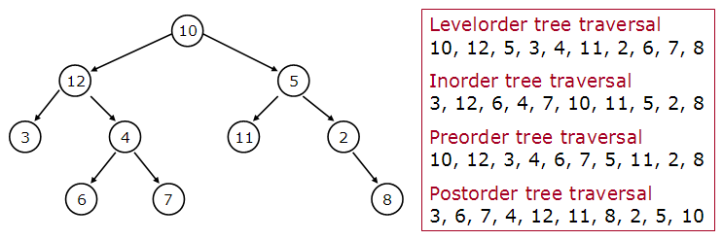
Example

Slide 40
Example

